Slide 1
Open Source Projects
Jason Newell, Applications Architect, The Charles Machine Works, Inc.

Slide 2
Why are we talking about open source?
2012
Mark Burhop jumped through a lot of hoops to get permission to create the first Solid Edge open source project. We took the open source plunge and uploaded all of our developer day content onto CodePlex at http://solidedge.codeplex.com. Unfortunately, the project has not been updated since.
2013
During my yearly contract renewal with Siemens, I proposed that Siemens allow me to carry the torch that Mark had started. I saw great potential and opportunity in the open source arena for the Solid Edge Developer Community. I authored and maintained several Solid Edge open source projects that year.
Samples for Solid Edge on CodePlex
Interop for Solid Edge on CodePlex
Spy for Solid Edge on CodePlex
Solid Edge Community on CodePlex

Slide 3
Why are we talking about open source?
2014
We have continued the open source work and we have learned a few things along the way. CodePlex was a great start but as the number of projects grew, it quickly started feeling too segregated between projects. Also, due to various reason, the barrier of entry for new contributors was too high.
If we want the Solid Edge Developer Community open source initiative to thrive, some changes needed to be made.

Slide 4
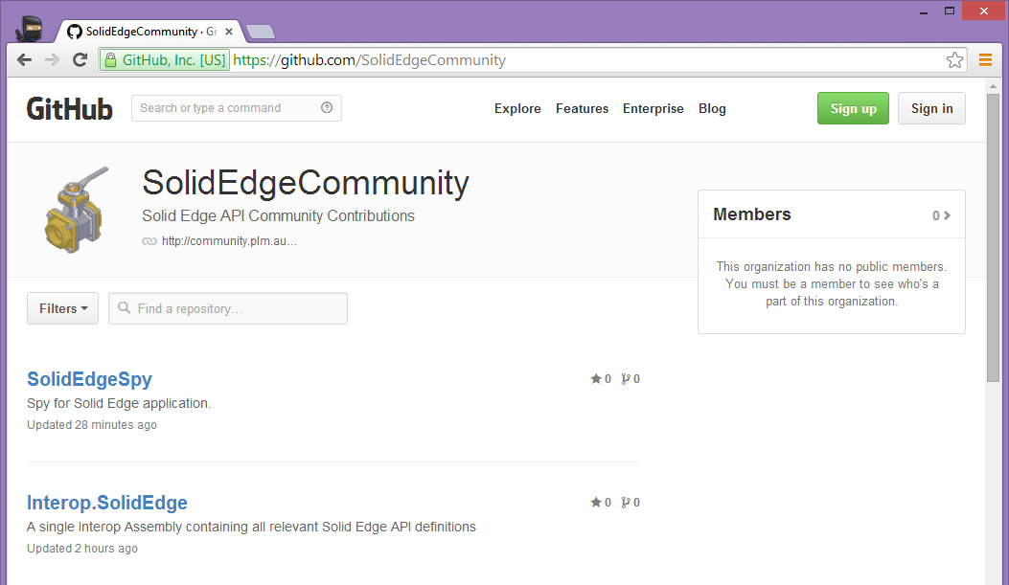
Welcome to the Solid Edge Community on GitHub

Slide 5
Solid Edge Community on GitHub
I have spent the last two years in the open source trenches. I speak from personal experience when I say that GitHub is the best choice for our community’s open source initiative.
Our community has never been in a better position to accept new contributors. To quote the great Scott Hanselman, “Sometimes open source projects fail simply because only one or two people actually show up. Day after day. Using open source is easy, but making open source is hard.”.

Slide 6
Solid Edge Community on GitHub
Current repositories
SolidEdgeSpy - Spy for Solid Edge application
Interop.SolidEdge - A single Interop Assembly containing all relevant Solid Edge API definitions
Templates - Solid Edge automation templates
SolidEdgeSamples - Community contributed samples of automating Solid Edge
SolidEdgeContrib - Community contributions for Solid Edge API
SolidEdgeContrib.Reader - Library for reading Solid Edge files
EmbedResources - Embeds BMP\PNG files into an assembly as native resources

Slide 7
Open source benefits
We all spend way too much time “reinventing the wheel”. Open source encourages us to share our hard work with others and consume theirs when we need it.
I’ve had two awesome projects since 2005 that I kept to myself, Solid Edge Spy and PowerToys for Solid Edge. Until recently, that was the normal mindset. I wrote it, it’s mine. For me, it was a competitive advantage mindset. I have since realized the value of open source and shared my code for the two projects.
At the end of 2013, I rewrote Solid Edge Spy from the ground up and renamed it Spy for Solid Edge. Every line of code is available on GitHub. PowerToys was a suite of applications and Windows shell extension written in C++. I ported the code to .NET and published it on GitHub (SolidEdgeContrib.Reader). That library has the ability to read Solid Edge files without any Solid Edge API. How cool is that!

Slide 8
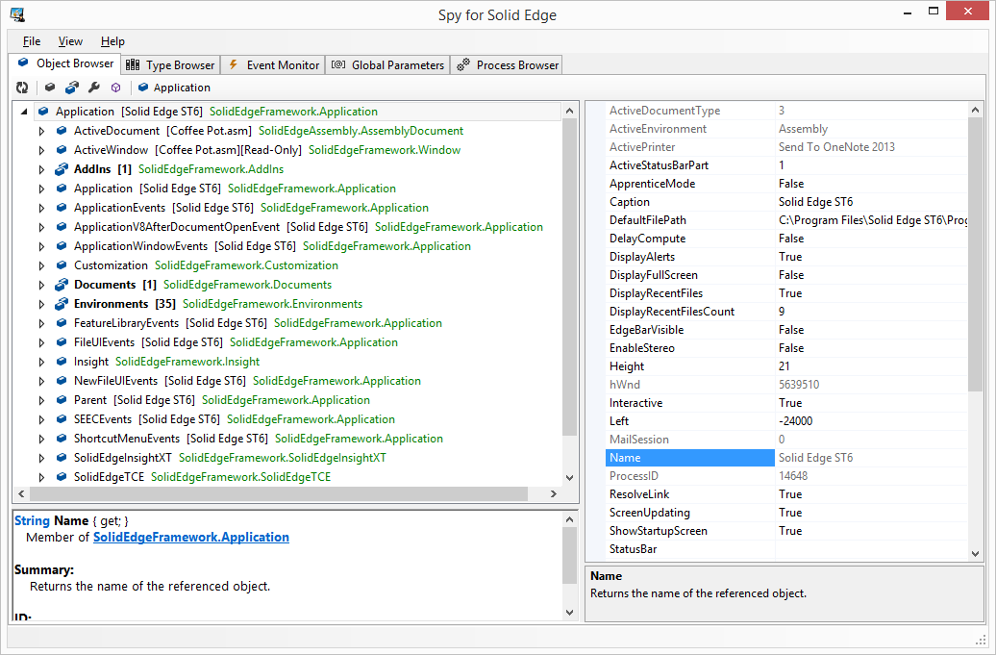
Spy for Solid Edge

Slide 9
What is NuGet?
“NuGet is the package manager for the Microsoft development platform including .NET. The NuGet client tools provide the ability to produce and consume packages. The NuGet Gallery is the central package repository used by all package authors and consumers.”
If you’re not using NuGet, you’re doing it the hard way! There are thousands of very useful NuGet packages (mostly open source) that you can simply add to your project and use.
Several of Solid Edge Community open source projects on GitHub are available in binary form on NuGet.
Interop.SolidEdge - nuget.org/packages/Interop.SolidEdge
SolidEdgeContrib - nuget.org/packages/SolidEdgeContrib
SolidEdgeContrib.Reader - nuget.org/packages/SolidEdgeContrib.Reader

Slide 10
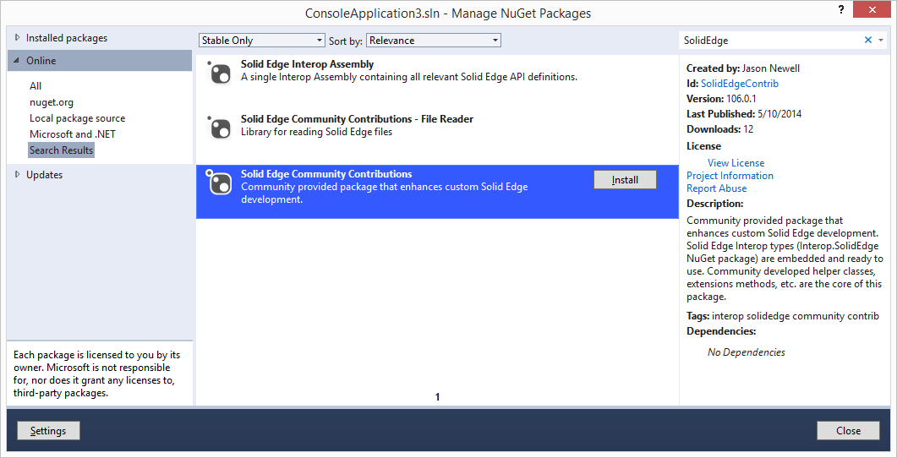
Solid Edge Community NuGet Packages
It really is as simple as clicking an Install button…

Slide 11
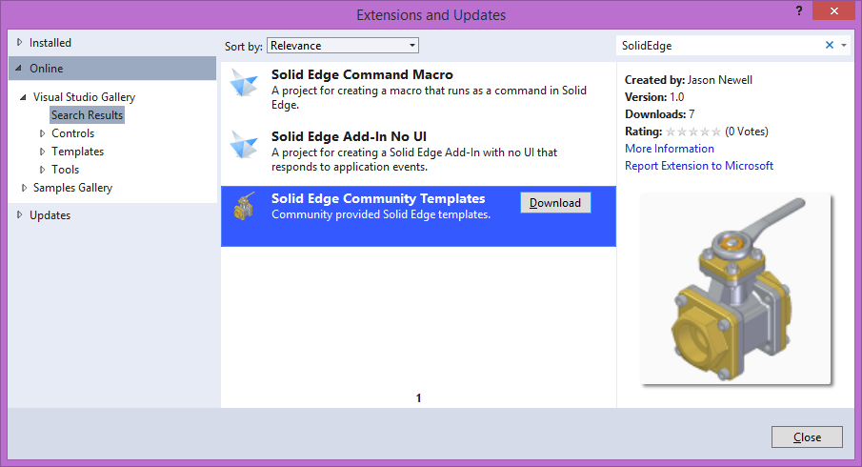
Visual Studio Gallery
Solid Edge Community Templates on visualstudiogallery.msdn.microsoft.com.

Slide 12
My thoughts on open source
I’m a 17 year IT veteran and have been programming for 15 years. I’ve been doing this long enough that I remember when open source was “just for Linux”. Those days are over. Microsoft has recently completely embraced open source and made it much easier for us to participate.
It is normal for most people to initially feel uneasy about open source. There has been a long running stigma toward open source. I’ve seen it time and time again when I talk about the work I’ve been doing.
Can I trust the author and the quality of their work?
I don’t want to have dependencies on open source libraries.
My thoughts on those concerns? Ok, don’t use them. Nobody is making you. The code is open sourced! Go look for yourself and see how the author implemented the functionality you need. You are free to take what you need but remember, someone spent time figuring it out.

Slide 13
Homework
Learn how to use NuGet. There is a ton of information at nuget.org.
Learn how to use GitHub. There is a ton of information at github.com.
Participate in the Solid Edge Community at github.com/SolidEdgeCommunity.
If you find an issue, report it!
Make new feature suggestions.
Request to become a contributor. It’s only me right now :-)

Slide 14
Questions
?

